Slide 1
Unity

Slide 2
What is Unity?
unity discusses the need to tie the various elements of a work of art together
Unity is a measure of how the elements of a page seem to fit together - to belong together
A unified work of art represents first a whole, then the sum of its parts.
Ways to Achieve Unity

Slide 3
Why is Unity Important?
Unity creates a sense of order. When a design possesses unity there will be a consistency of sizes and shapes, as well as a harmony of color and pattern. One way this is accomplished is by repeating the key elements, balancing them throughout the composition, and then adding a little variety so that the design has its own sense of personality. Learning to juggle the elements and principles in such a way as to achieve the right mix is a key to good design.

Slide 4
Unity also gives elements the appearance of completeness, that they belong together. When a composition has unity the design will be viewed as one piece, as a whole, and not as separate elements with the painting. Using too many shapes and forms may cause a design to be unfocused, cluttered and confusing. A well organized design will be achieved by using a basic shape which is then repeated throughout the composition.

Slide 5
When Unity is Acheived
The individual elements with in a composition will not be competing for attention.
The key theme will be communicated more clearly.
The design will evoke a sense of completeness and organization.

Slide 6
To create unity you must have a clear objective in mind you are wanting to communicate to the viewer. You have stay focused on achieving the objective and not deviate from it. If there is an element you are considering adding to a composition does not contribute to the objective then it should not be added to the design.
You also need to be analytical about your work, maintaining objectivity at all times, and accept critiques from peers, friends, and family members. When the purpose and message you intend to portray is consistently understood the same way by several people then the principle of unity has been maintained within your painting.
When you feel your composition is complete, take a step back and observe it with an objective eye. The final test of unity is one in which nothing can be added to or taken away without having to rework the entire composition. The relationship of all the elements should be so strong it would actually hurt the design to add or remove any one thing. When nothing can distract from the whole you have unity. However, in your efforts to achieve unity you need to keep in mind that too much unity without variety is boring and too much variation without unity is chaotic.

Slide 7
Similarity
Try repeating colors, shapes, values, textures, or lines to create a visual relationship between the elements. Repetition works to unify all parts of a design because it creates a sense of consistency and completeness.

Slide 8
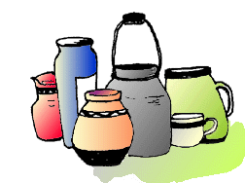
Proximity
The simplest method of making objects appear to belong together is to group them closely together. This allows us to see a pattern.

Slide 9
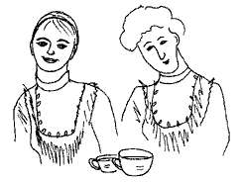
Repetition
Another method often used to promote unity is the use of repetition.
Repetition of color, shape,
texture or object can be
used to tie a work together.

Slide 10
Continuation
A much more subtle method of unifying a work involves the continuation of line, edge or direction from one area to another.
Continuation is often used in books and magazines to tie the elements of a page together with the use of rules, and by lining up edges of copy, headlines and graphics.

Slide 11
Alignment
Arranging shapes so that the line or edge of one shape leads into another helps creates unity in your design. When an element is placed in a composition, it creates an implied horizontal and vertical axis at its top, bottom, center and sides. Aligning other elements to these axes creates a visual relationship which unifies them.

Slide 12
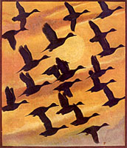
Unity is created with the effective use of repetition.

Slide 13
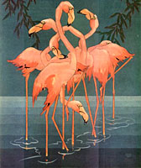
On the right grouping of similar objects (proximity) was used to create unity within this painting.

Slide 14
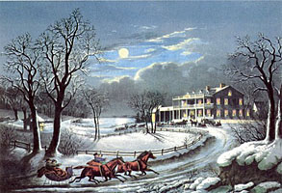
The road in this painting is the "third element" that helps to create a relationship between the people in the foreground to the people in the background.

Slide 15
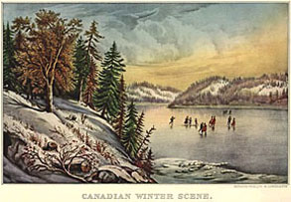
This painting is another good example of how proximity creates relationships between related objects.

Slide 16
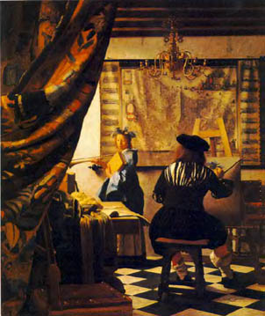
“Vermeer”

Slide 17
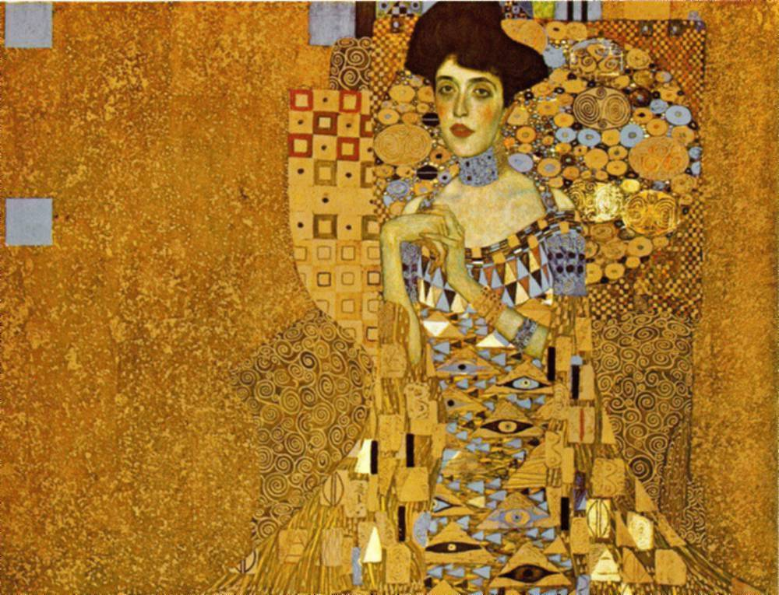
“Klimt”

Slide 18
The End

